Slide 1
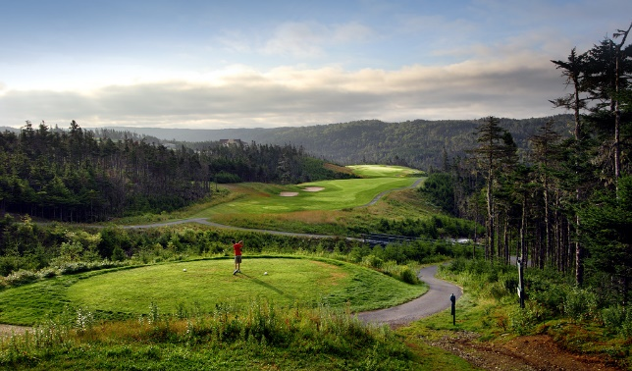
12th Annual Mazol Shriners Charity Golf Tournament in support of Mazol Temple Patient Transportation Fund for children with orthopaedic conditions, burns, spinal cord injuries, and cleft lip and palate. http://www.mazolshriners.com
Date: September 15th, 2016
Location: The Wilds Golf Course, Salmonier Line
Tee time: 8am (shotgun start)
To sign-up
709 368 5199
709 364 1591 (Office)
rosep2268@gmail.com
willowridge77@gmail.com
Tournament Details
Team entry fee $950 or $250 fee for singles. Participating teams will be recognized on the Tournament Scorecard. Companies or individuals may also pay $200 to sponsor a hole, and will be recognized by an appropriate sign.
Teams/players get 18 holes of golf (best ball format), a steak dinner, prizes, loot bag, and a chance for the hole-in-one prize.
The Grand Prize is a “stay and play” for the winning team, consisting of four rounds of golf and accommodations supplied by the Wilds . There are also prizes for the longest drive, beating the Potentate, closest to the hole, putting contest, etc.. ,
Golf carts are not included but can be rented on-site.
http://www.thewilds.ca

